Slide 1
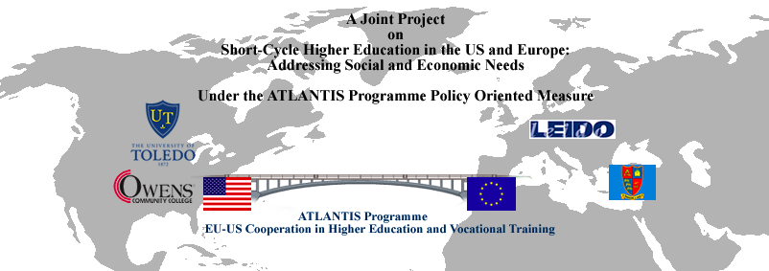
Higher Education in the
United States
October 13, 2009
Much of presentation adapted from Eckel (2004). An Overview of Higher Education in the United States …Chronicle of Higher Education

Slide 2
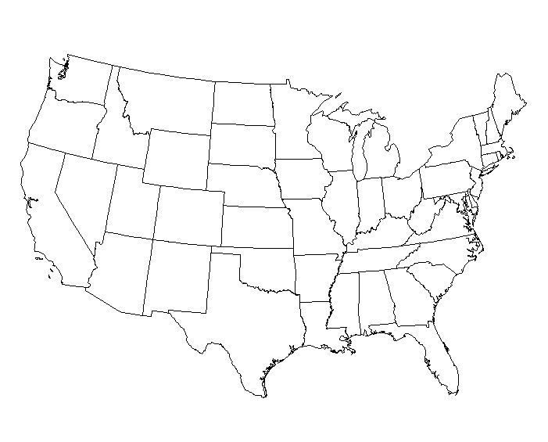
…important exceptions exist to almost every characteristic that will be discussed…

Slide 3






History
Emmanuel College
Lay Governance
Research
18th Century view of Harvard from Harvard University Home Page
Liberal Arts Tradition
Liberal Arts Tradition

Slide 4
Jeffersonian Ideas
Access
“…HOWEVER…its character is profoundly influenced by three major philosophical beliefs that shape American public life…”
… limited government & freedom of expression
…states , religious communities , & individuals established and maintain wide range of HIE institutions
…continue to protect them from levels of government control seen on other counties.
…widespread commitment to equal opportunity & social mobility
…elite for much of its history
…20th century --- gateway to middle-class
Capitalism
…belief in the rationality of markets
…American C/Us via for faculty, students, $$$
…assume diversity & quality best achieved by competition rather than centralized planning
“…borrowed from both the British undergraduate college and the German research university…”

Slide 5
Students
At public 4-year institutions | 6,055,398
At public 2-year institutions | 5,697,388
At private 4-year institutions | 3,308,460
At private 2-year institutions | 251,043
Undergraduate | 13,155,393
Graduate | 1,850,271
Professional | 306,625
American Indian | 151,150
Asian | 978,224
Black | 1,730,318
Hispanic | 1,461,806
White | 10,462,099
Foreign | 528,692
Total | 15,312,289
17. 3 Million

Slide 6
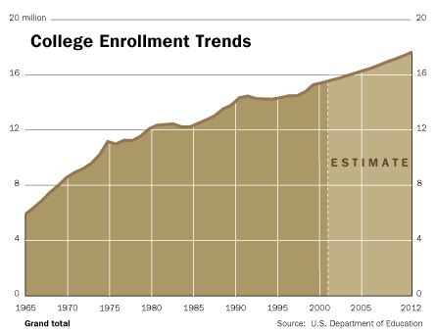
Enrollment Trends

Slide 7
Number of High School Graduates,
1992-2022: Ohio
Source: WICHE/The College Board
Notes:
Slide I-33 Higher Education’s Landscape 33
The total number of high school graduates in Ohio changes very little between 1992-93 and 2021-2022, ranging from 115,906 in 1991-92 to a projected 117,361 in 2021-22, an increase of only 1%. A gradual trend downward is projected, however, beginning in 2010.
All four groups of non-White graduates in Ohio are projected to show some growth over the 25-year period of the graph. The largest increases are expected among Hispanic (503%) and Asian (243%) students.
Source: Western Interstate Commission for Higher Education, Knocking at the College Door: Projections of High School Graduates by State and Race/Ethnicity 1992 to 2022, 2008. Racial/ethnic breakdowns are available for public graduates only.

Slide 8
Number of High School Graduates,
1992-2022: Texas
Source: WICHE/The College Board
Notes:
Slide I-34 Higher Education’s Landscape 34
Source: Western Interstate Commission for Higher Education, Knocking at the College Door: Projections of High School Graduates by State, Income and Race/Ethnicity 1988-2022, 2003. Racial/ethnic breakdowns are available for public graduates only.

Slide 9
COLLEGES AND UNIVERSITIES
Postsecondary Institutions
Colleges and Universities (award degrees) 4200
Institutions award vocational certificates 2300
6500
Higher education:
Public 4-year institutions | 634
Public 2-year institutions | 1,086
Private 4-year institutions, nonprofit | 1,546
Private 4-year institutions, for-profit | 350
Private 2-year institutions, nonprofit | 118
Private 2-year institutions, for-profit | 502
Total | 4,236
Only 634 public four-year colleges and universities in USA

Slide 10
Pro-Profits
Primarily offer vocational programs
Certificates rather than degrees
approximately 2,400
500 offered 2-yr associate degree
320 offer bachelor’s degree
enroll +/- 750,000 students
all but 50,000 @ UG level
Source --- US Dept of Ed

Slide 11
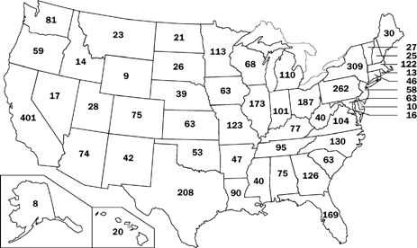
Colleges & Universities
4236

Slide 12
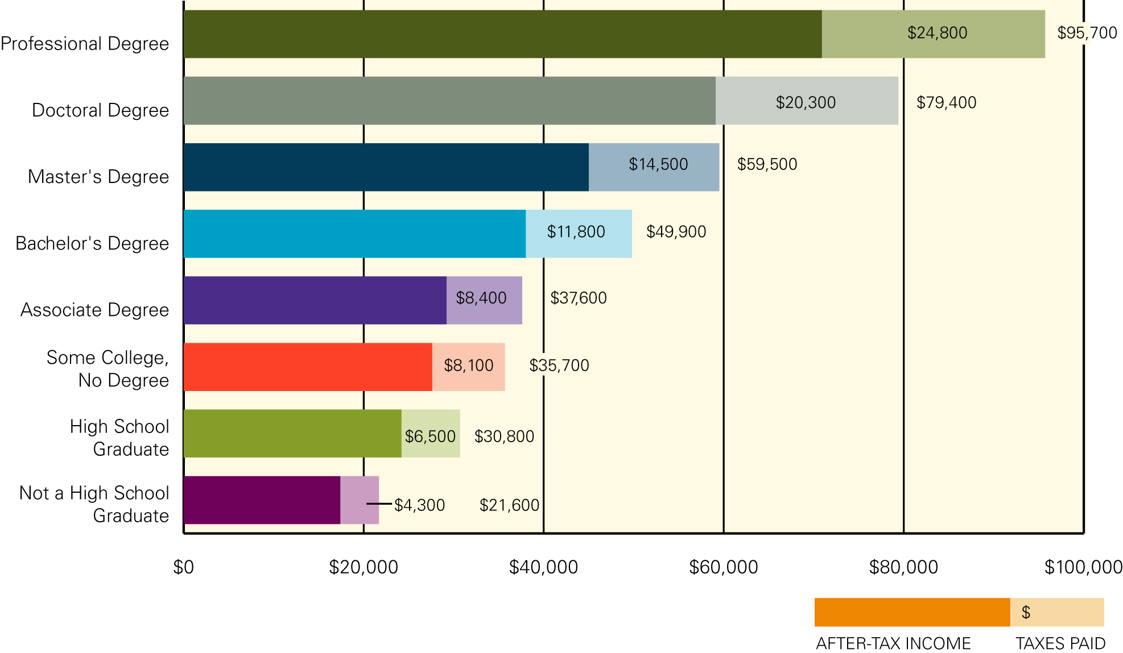
Median Earnings and Tax Payments by Level of Education, 2003
$$$ Education Pays $$$
Note: Includes full-time year-round workers age 25 and older.
Source: U.S. Census Bureau, 2004a, PINC-03; Internal Revenue Service, 2004,
Table 3; McIntyre, et al., 2003; calculations by the authors.

Slide 13
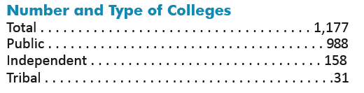
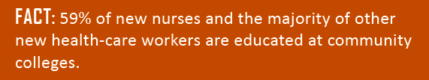

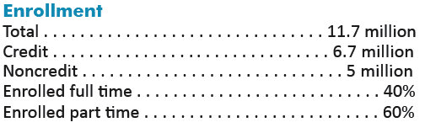
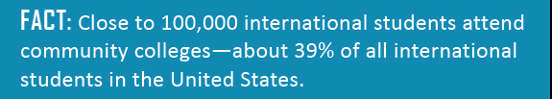

IMPORTANT
FACTS
ABOUT
U.S.
COMMUNITY COLLEGES
Source: AACC Fact Sheet 2009

Slide 14
Jobs for 15 million people
“Community colleges have become the place for anyone with the desire to take their career to a new level — or start a new career altogether.”
President Barack Obama’s remarks at the Hudson Valley Community College in Troy, MI…July 14, 2009
$12 Billion for CCs

Slide 15
US Constitution
AS A RESULT
  Each of the 50 states is responsible for governing public colleges and universities
  75% of enrolled @ publics
Degree of control varies TREMENDOUSLY
…reserves for the states all government functions not specifically described as federal…
…among those functions is EDUCATION

Slide 16
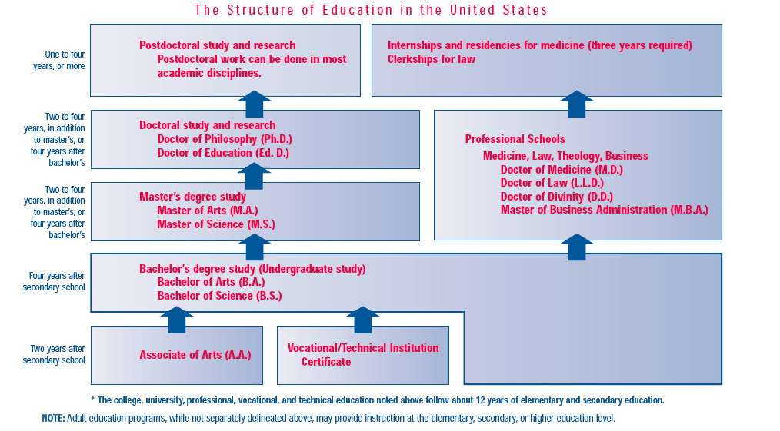
4
5
3
2
Offer 5 types of degrees
1
(From A Brief Guide to U.S. Education, American Council on Education, 2001, pg. 7)

Slide 17
Accreditation
a process of external quality review used by higher education to scrutinize colleges, universities and educational programs for quality assurance and quality improvement.
In the United States, accreditation is carried out by private, nonprofit organizations designed for this specific purpose.
Institutions and educational programs seek accredited status as a means of demonstrating their academic quality to students and the public and to become eligible for federal funds.
From CHEA Fact Sheet #1, October 2008
7,006 institutions are accredited
19,453 programs are accredited

Slide 18

Higher Education GOVERNANCE STRUCTURES

Slide 19
Diversity in Governance among the States
Coordinating Board
Governing Board
Both Coordinating & Governing Board
No Statewide Board
From: Paul Lingenfelter, Higher Education Governance in and among the United States (presentation to OECD/IMHE-August 24, 2006)

Slide 20
State Coordination vs. State Governance
Statewide coordinating Boards:
  Do planning, budgeting, and program authorization/review
  Have no or a very limited role in personnel and institutional operations (functions of governing boards for individual institutions in these states)
  May operate state financial aid and grant programs
  May or may not be closely controlled by the Governor (Executive Branch)
  Vary considerably in influence and power
From: Paul Lingenfelter, Higher Education Governance in and among the United States (presentation to OECD/IMHE-August 24, 2006)

Slide 21
State Coordination vs. State Governance
Statewide Governing Boards:
  Are responsible for personnel decisions, institutional operations, and corporate governance
  Do planning and budgeting
  Are rarely, but occasionally closely controlled by the Governor (Executive Branch)
  Vary in the allocation of powers between the Board’s CEO and institutional CEOs in the system
From: Paul Lingenfelter, Higher Education Governance in and among the United States (presentation to OECD/IMHE-August 24, 2006)

Slide 22
State Coordination vs. State Governance
Coordinating and Governing Boards may be:
  Appointed by Governors (most common)
  Elected directly by the people (less common, and only for Governing Board members)
  Selected in part by the Governor and in part by others, included the legislature and sometimes alumni
  Students, often without vote, sometimes serve as Board members.
From: Paul Lingenfelter, Higher Education Governance in and among the United States (presentation to OECD/IMHE-August 24, 2006)

Slide 23

The Federal Presence
The American system of higher education has developed within a framework of evolving federal influence and intervention.
It has been argued that historically, national policy has contributed to excellence and value.
INFLUENCE

Slide 24
Federal Government
each state is responsible for most aspects of education within its boarders
state authority over private colleges and universities is very limited!
DOES NOT
  exercise control
  serves as primary funder of U.S. higher education
  many other countries do through their ministries of education
EXCEPTIONS
  several federal institutions
    Howard University
    Military Academics
    31 tribal colleges

Slide 25

Professional Associations
  ACE
  AACC
  AAU
  AASCU
  NASULGC
  NAICU
Lobbying for Higher Education Policies and Representation
  The Big 6
  The American Council on Education (ACE)
  -national coordinating body for American higher education- represents all accredited colleges and universities-both public & private
  American Association of Community Colleges (AACC)
  Association of American Universities (AAU)
  American Association of State Colleges and Universities (AASCU)
  National Association of State Universities and Land Grant Colleges (NASULGC)
  National Association of Independent Colleges and Universities (NAICU)
All Voluntary
Examples

Slide 26
The Federal Presence
AAU
NAICU
NASULGC
ACE
AACC
AASCU

Slide 27
Proprietary
Schools
COALITIONS
CAMPUS REPS
Examples of C/Us w/DC reps
Miami Dade Community College
University of California System
Princeton University
THE BIG SIX
ACE
AAU
NAICU
NASULGC
AACC
AASSU
OTHER HIGHER ED ASSO
Examples of specialized associations
Association of medical Colleges (AAMC)
American Chemical Society (ACS)
Nat’l Asso of Student Fin Aid Admin (NASFAA)
United Negro College Fund (UNCF)
United States Student Association (USSA)
HIRED GUNS
Lobbyists
CONGRESS

Slide 28
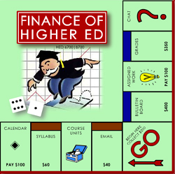

Slide 29
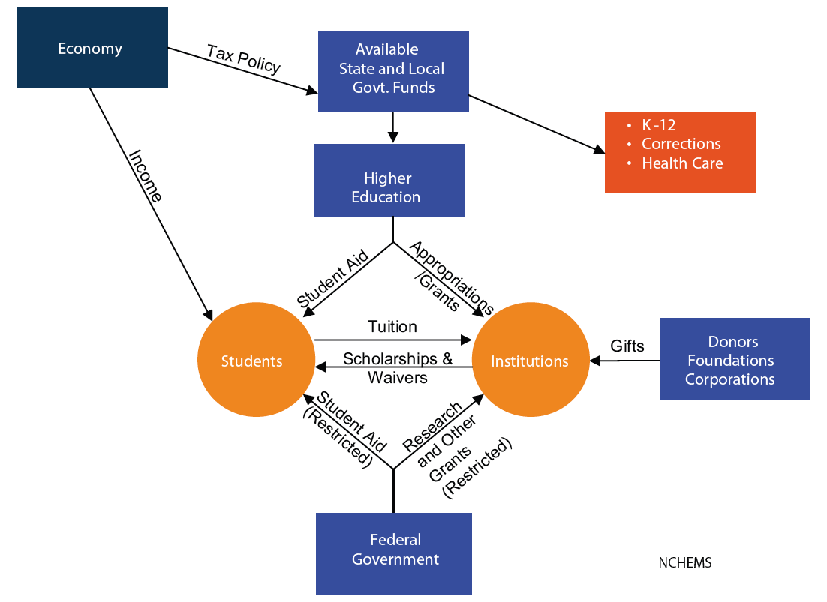

Slide 30
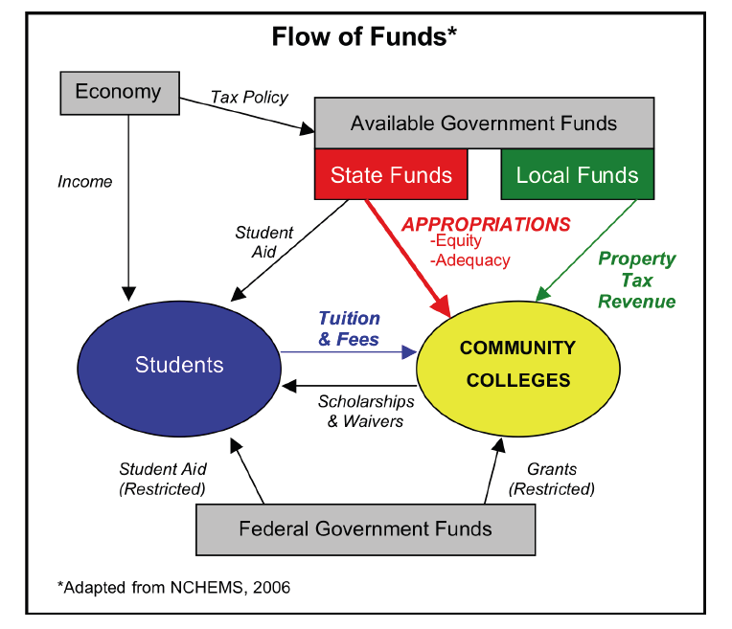
From Hudson Dissertation 2008

Slide 31
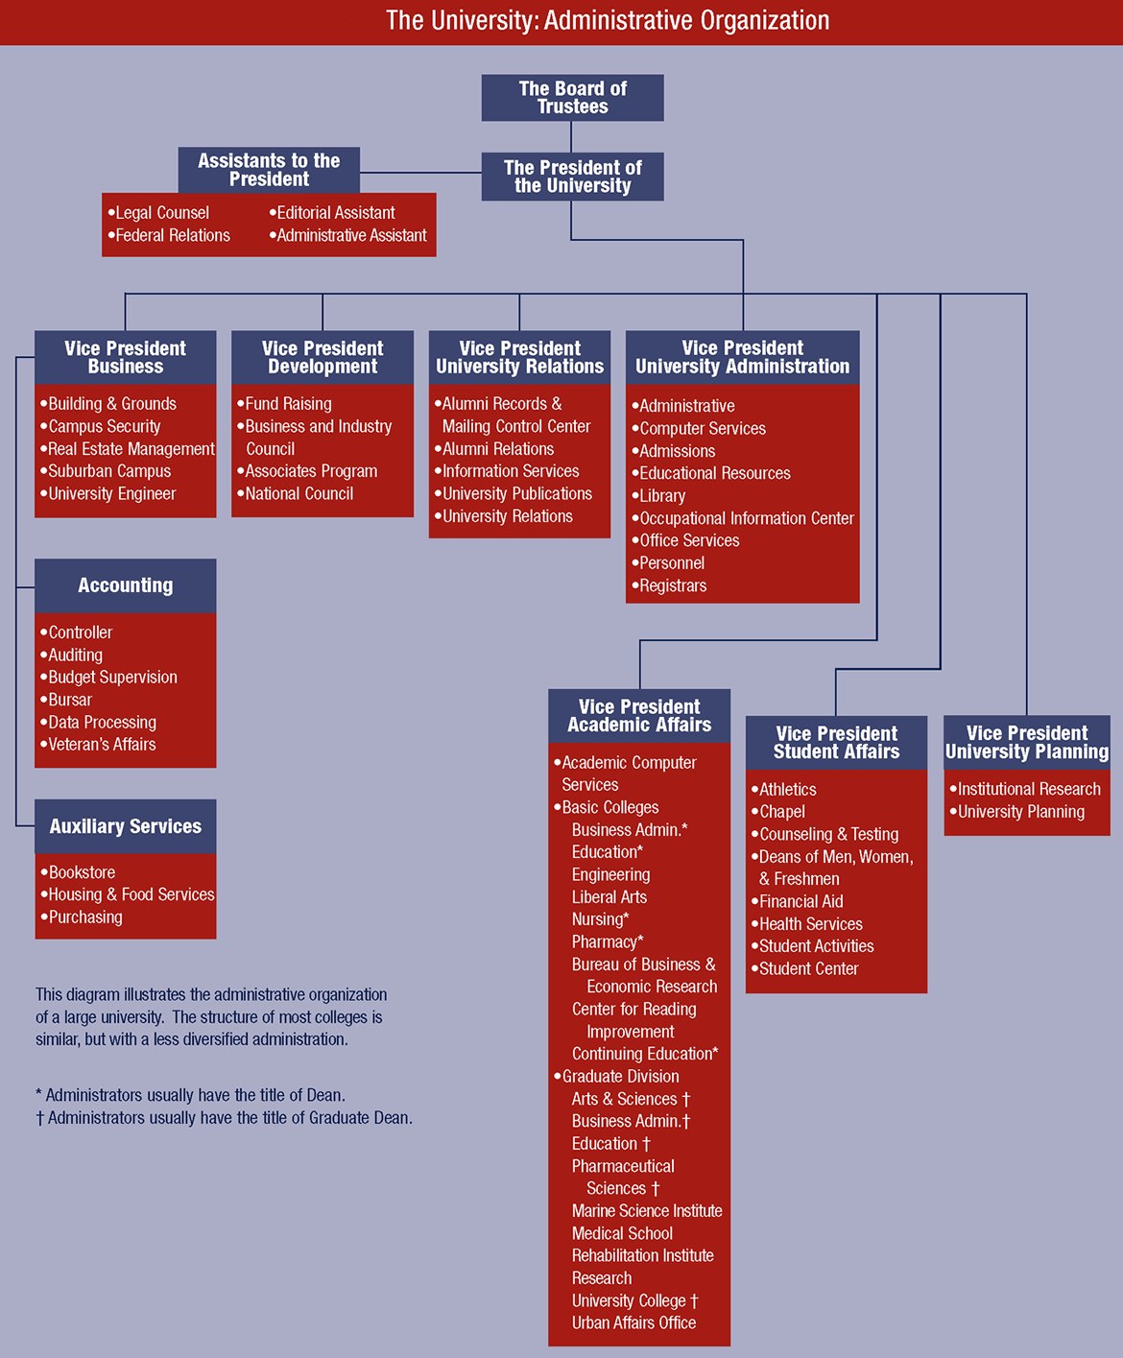

Slide 32
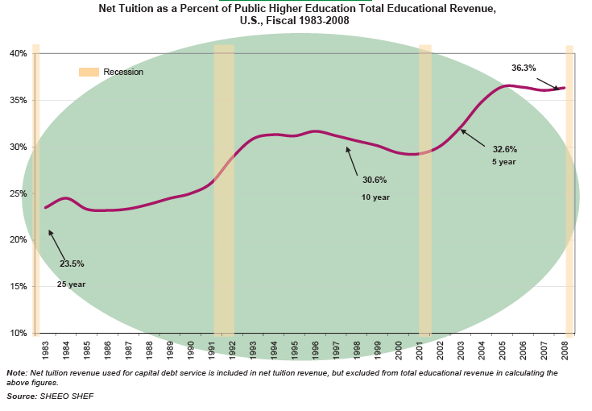

Slide 33
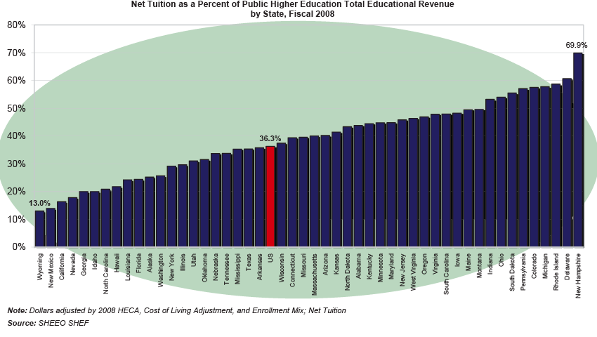

Slide 34

UG tuition, room & board -AY 2007-08
Public Institutions……………………..$11,578
Private Institutions……..……………..$29,915
Price increases between 1997-98 & 2007-08
(UG tuition, room & board-adjusted for inflation)
Public Institutions 30%
Private Institution 23%

Slide 35
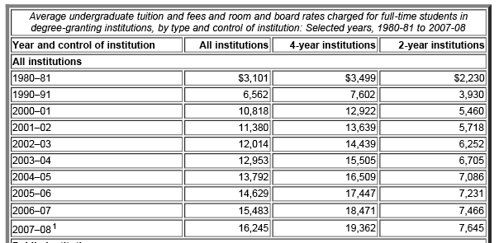
$19,362
$7,645

Slide 36
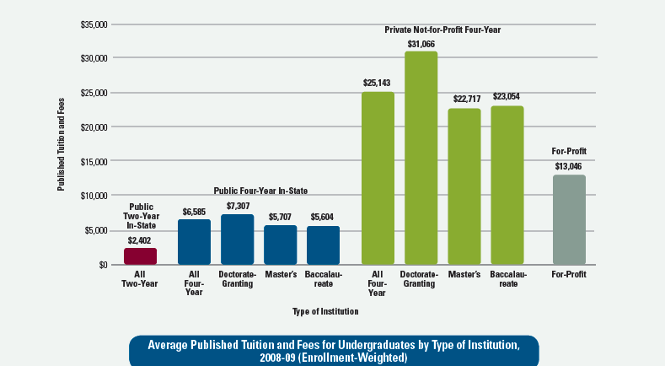
Tuition & Fees download from CEEB http://professionals.collegeboard.com/profdownload/types-of-institutions-trends-2008.pdf

Slide 37
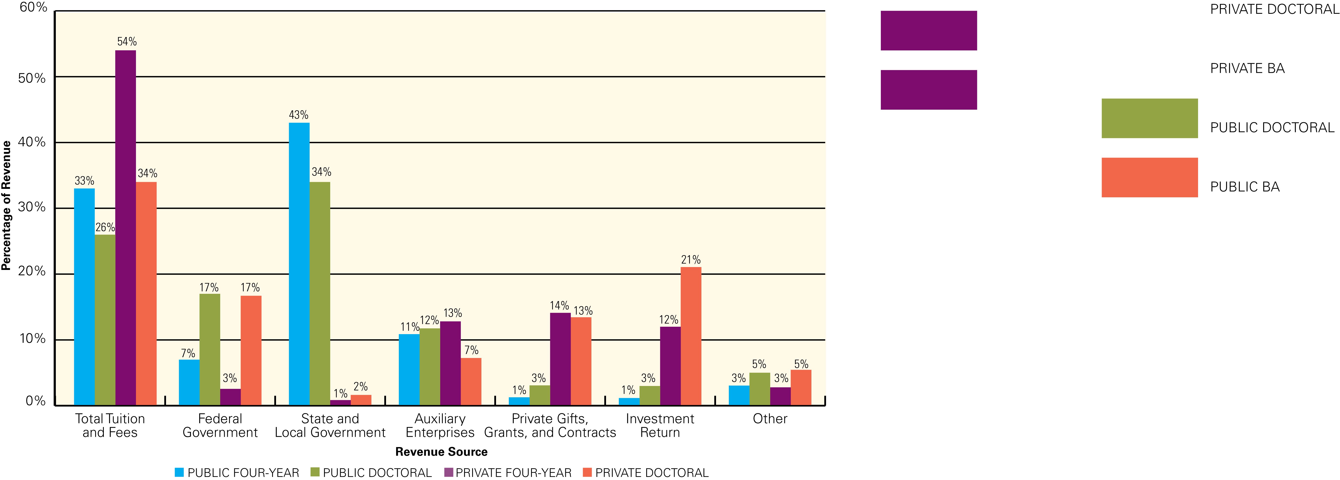
Revenue Sources: Public Four-Year Colleges, Public Doctoral Universities, Private Four-Year Colleges, and Private Doctoral Universities, 2005-06
Gross Tuition & Fees (TF) Revenue
Pvt 4-year UG college – 54% compared to 34 % at Pvt doctoral universities.
TF constitute 33 % of revenues at Pub 4-year UG colleges & 26 % at Pub doctoral universities.
Notes: Tuition and fee revenues reported here are gross revenues, including tuition and fees and discounts for institutional aid. Federal revenues include Pell Grants for most public institutions, but not for private institutions. At all institutions, federal revenues include grants and contracts for research, public service, and training activities. Auxiliary enterprises include dormitories, food services, health services, and other self-supporting enterprises. Investment return revenues are average dollar returns over a five-year period.
Sources: Preliminary data from IPEDS, 2005-06; calculations by authors.
Source: CEEB – Trends in Higher Education Series 2007

Slide 38
Low Cost Option
Relatively inexpensive option for students and taxpayers
Tuition varies widely by state but in every state cost less than four- year
CCs are the primary way most states deliver post-secondary education!
In 33 states cost is half or less than four-year schools
Total cost of operation is about 1/3rd of public four-year, graduate research institution.

Slide 39
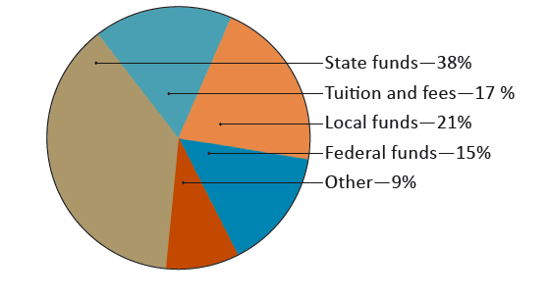
Revenue Sources
Public Community Colleges
Source: AACC Fast Facts 2009

Slide 40
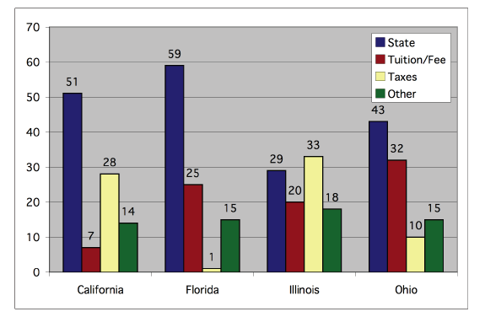
Variation in Community College
Funding Sources
From Hudson Dissertation 2008

Slide 41
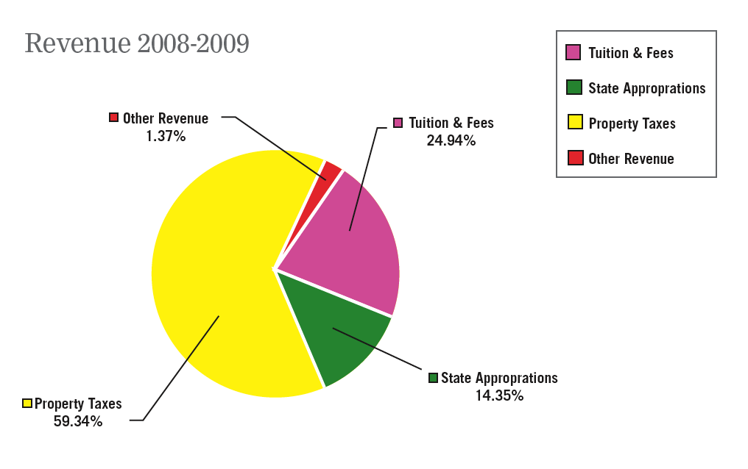
Wayne County Community College District
From Financial Plan 2008

Slide 42
2009
…negotiated with the Michigan legislature…
…tool for employers to obtain highly skilled workers that are need for company’s success…
Unique collaboration between Community Colleges, State legislature to address needs of businesses expanding or coming to the state.

Slide 43
Michigan
Community College enter into contract with a company…
CC will either self-fund or issue bonds to cover cost of training needed (facilities, faculty, etc.)…
CC repaid through diversion of employee withholding taxes generated by wages earned by new employees…
New Jobs Training Program

Slide 44
The Expectation
“By 2020, America will once again have the highest proportion of college graduates in the world.”
President Barack Obama, February 24, 2009

Slide 45
Associate and Bachelors Degrees Needed to Become the Most Educated Country by 2020
Additional Annual Degree Production Needed – 150,528 per Year
Current Annual Degree Production – 2,252,212
Increase in State and Local Funding at Current Cost per FTE
Note: Assumes private institutions will maintain current share

Slide 46
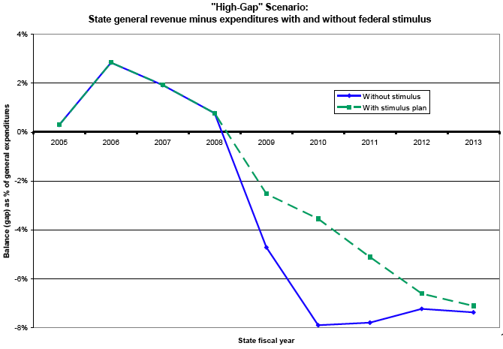
Source: Boyd (2009) Fiscal Stimulus and State & Local Governments. Rockefellow Institute of Government

Slide 47
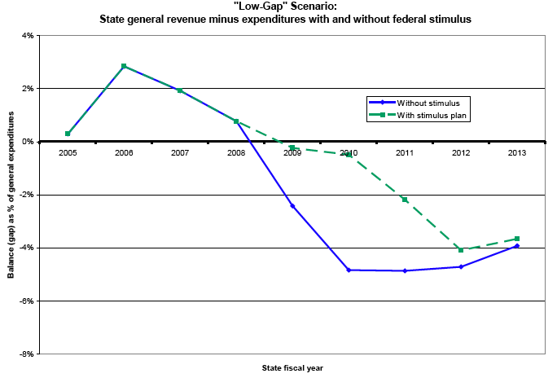
Source: Boyd (2009) Fiscal Stimulus and State & Local Governments. Rockefellow Institute of Government

Slide 48

That’s All Folks

